Slide 1
S2-19_DSECLZC415 Classification and Prediction
Presented by Dr. D.VENKATA SUBRAMANIAN
May 16 2020 - SESSION 4
Slide Courtesy: Prof. T.V. Rao

Slide 2

The slides presented here are obtained from the authors of the books and from various other contributors. I hereby acknowledge all the contributors for their material and inputs.
I have added and modified a few slides to suit the requirements of the course.

Slide 3
Classification
Classification involves dividing up objects so that each is assigned to one of a number of mutually exhaustive and exclusive categories known as classes
Many practical decision-making tasks can be formulated as classification problems
customers who are likely to buy or not buy a particular product in a supermarket
people who are at high, medium or low risk of acquiring a certain illness
student projects worthy of a distinction, merit, pass or fail grade
objects on a radar display which correspond to vehicles, people, buildings or trees
people who closely resemble, slightly resemble or do not resemble someone seen committing a crime
houses that are likely to rise in value, fall in value or have an unchanged value in 12 months' time
people who are at high, medium or low risk of a car accident in the next 12 months
people who are likely to vote for each of a number of political parties (or none)
the likelihood of rain the next day for a weather forecast (very likely, likely, unlikely, very unlikely).

Slide 4
Supervised vs. Unsupervised Learning
Supervised learning (classification)
Supervision: The training data (observations, measurements, etc.) are accompanied by class labels indicating the class of the observations
New data is classified based on the training set
Unsupervised learning (clustering)
The class labels of training data is unknown.
Also, number of classes to be learned may not known in advance.
Given a set of measurements, observations, etc. with the aim of grouping a set of objects in such a way that objects in the same group (or cluster) are more similar to each other than to those in other groups (clusters).
Eg. Marketing: Helps to discover distinct groups in their customer bases, depending on their buying patterns and then use this knowledge to develop targeted marketing program.

Slide 5
Prediction Problems: Classification vs. Numeric Prediction
Classification
predicts categorical class labels (discrete or nominal)
classifies data (constructs a model) based on the training set and the values (class labels) in a classifying attribute and uses it in classifying new data
Numeric Prediction
Models constructed predicts continuous-valued functions, i.e., predicts unknown or missing values
Suppose that the marketing manager wants to predict how much a given customer will spend during a sale.

Slide 6
Classification—A Two-Step Process
Model construction: describing a set of predetermined classes
Each tuple/sample is assumed to belong to a predefined class, as determined by the class label attribute
The set of tuples and their associated class labels, used for model construction is training set
The model is represented as classification rules, decision trees, or mathematical formulae
Model usage: for classifying future or unknown objects
Estimate accuracy of the model
The known label of test sample is compared with the classified result from the model
Accuracy rate is the percentage of test set samples that are correctly classified by the model
Test set is independent of training set (otherwise overfitting)
If the accuracy is acceptable, use the model to classify new data
Note: If the test set is used to select models, it is called validation (test) set

Slide 7
Process (1): Model Construction
Classification
Algorithms
Training
Data
Classifier
(Model)
IF rank = ‘professor’
OR years > 6
THEN tenured = ‘yes’

Slide 8
Process (2): Using the Model in Prediction
Classifier
Testing
Data
Unseen Data
(Jeff, Professor, 4)
Tenured?

Slide 9
Illustrating Classification Task

Slide 10
Classification Techniques
Decision Tree based Methods
Rule-based Methods
Neural Networks
computational networks that simulate the decision process in neurons (networks of nerve cell)
Naïve Bayes and Bayesian Belief Networks
uses the probability theory to find the most likely of the possible classifications
Support Vector Machines
fits a boundary to a region of points that are all alike; uses the boundary to classify a new point

Slide 11
Lazy vs. Eager Learning
Lazy vs. eager learning
Lazy learning (e.g., instance-based learning): Simply stores training data (or only minor processing) and waits until it is given a test tuple
Eager learning : Given a set of training set, constructs a classification model before receiving new (e.g., test) data to classify
Eager learning (eg. Decision trees, SVM, NN): Given a set of training set, constructs a classification model before receiving new (e.g., test) data to classify
Lazy: less time in training but more time in predicting
Accuracy
Lazy method effectively uses a richer hypothesis space since it uses many local linear functions to form its implicit global approximation to the target function
Eager: must commit to a single hypothesis that covers the entire instance space

Slide 12
Lazy Learner: Instance-Based Methods
Instance-based learning:
Store training examples and delay the processing (“lazy evaluation”) until a new instance must be classified
Typical approaches
k-nearest neighbor approach
Instances represented as points in a Euclidean space.
Locally weighted regression
Constructs local approximation
Case-based reasoning
Uses symbolic representations and knowledge-based inference

Slide 13
Decision Tree Induction
Decision tree induction is the learning of decision trees from class-labeled training tuples.
Decision tree is a flowchart-like tree structure,
internal node (denoted by rectangles) denotes a test on an attribute,
each branch represents an outcome of the test, and
each leaf node (or terminal node, denoted by ovals ) holds a class label. It represents the concept buys computer, that is, it predicts whether a customer at
Used for classification.
Easily converted to classification rules.
Does not require any domain knowledge.
Decision tree algorithms: ID3(Iterative Dichotomiser), C4.5 (successor of ID3), CART(classification and regression trees).
Adopt greedy approach
Based on top- down recursive divide and conquer approach.

Slide 14
Decision Tree Induction: An Example
Training data set: Buys_computer
Resulting tree:
age?
youth
overcast
Senior
Midle_aged
student?
yes
credit rating?
no
yes
excellent
fair
no
yes
yes
no

Slide 15
Example of a Decision Tree
categorical
categorical
continuous
class
Splitting Attributes
Refund
Yes
No
NO
MarSt
Single, Divorced
Married
TaxInc
NO
< 80K
> 80K
NO
YES
Training Data
Model: Decision Tree

Slide 16
Apply Model to Test Data
Test Data
Refund
Yes
No
NO
MarSt
Single, Divorced
Married
Assign Cheat to “No”
TaxInc
NO
< 80K
> 80K
NO
YES

Slide 17
Decision Tree Classification Task
Decision Tree

Slide 18
Issues: Evaluating Classification Methods
Accuracy
classifier accuracy: predicting class label
predictor accuracy: guessing value of predicted attributes
Speed
time to construct the model (training time)
time to use the model (classification/prediction time)
Robustness: handling noise and missing values
Scalability: efficiency in disk-resident databases
Interpretability
understanding and insight provided by the model
Other measures, e.g., goodness of rules, such as decision tree size or compactness of classification rules

Slide 19
OVERFITTING VS UNDERFITTING
Overfitting occurs when a statistical model or machine learning algorithm captures the noise of the data. Intuitively, overfitting occurs when the model or the algorithm fits the data too well. Specifically, overfitting occurs if the model or algorithm shows low bias but high variance. Overfitting is often a result of an excessively complicated model, and it can be prevented by fitting multiple models and using validation or cross-validation to compare their predictive accuracies on test data.
Underfitting occurs when a statistical model or machine learning algorithm cannot capture the underlying trend of the data. Intuitively, underfitting occurs when the model or the algorithm does not fit the data well enough. Specifically, underfitting occurs if the model or algorithm shows low variance but high bias. Underfitting is often a result of an excessively simple model.
Both overfitting and underfitting lead to poor predictions on new data sets.

Slide 20
Underfitting vs. Overfitting
Underfitting results in decision trees that are too simple to solve the problem. They may offer superior interpretability.
Overfitting results in decision trees that are more complex than necessary
Training error no longer provides a good estimate of how well the tree will perform on previously unseen records
Need new ways for estimating errors

Slide 21
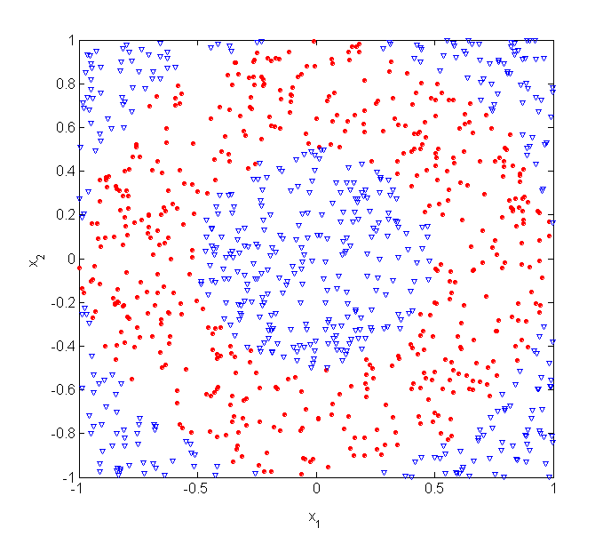
Underfitting and Overfitting (Example)
500 circular and 500 triangular data points.
Circular points:
0.5 ≤ sqrt(x₁²+x₂²) ≤ 1
Triangular points:
sqrt(x₁²+x₂²) > 0.5 or
sqrt(x₁²+x₂²) < 1
X₂ →
X₁ →

Slide 22
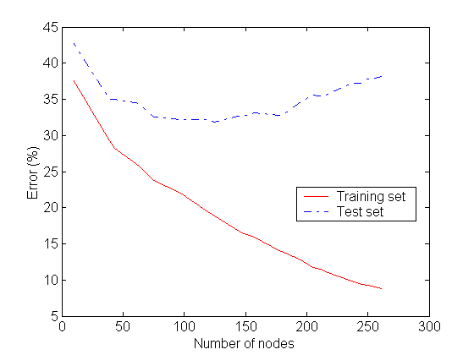
Underfitting and Overfitting
Overfitting
Underfitting: when model is too simple, both training and test errors are large

Slide 23
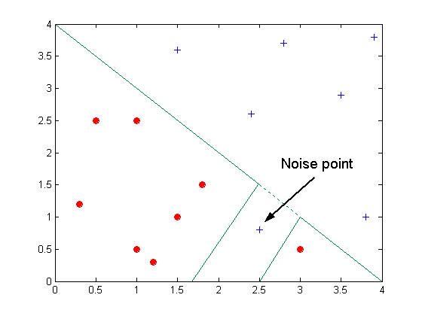
Overfitting due to Noise
Decision boundary is distorted by noise point

Slide 24
Decision Tree Based Classification
Decision trees are intuitive and frequently used data mining technique for Classification
For an analyst, they are easy to set up and for a business user they are easy to interpret.
A decision tree model is a decision flowchart where an attribute is tested in each node and ends in a leaf node where a prediction is made.
There are many algorithms for decision tree induction such as Hunt’s Algorithm, CART, ID3, C4.5, SLIQ,SPRINT

Slide 25
Example of a Decision Tree
categorical
categorical
continuous
class
Splitting Attributes
Refund
Yes
No
NO
MarSt
Single, Divorced
Married
TaxInc
NO
< 80K
> 80K
NO
YES
Training Data
Model: Decision Tree

Slide 26
Decision Tree Classification Task
Decision Tree

Slide 27
Algorithm for Decision Tree Induction
Basic algorithm (a greedy algorithm)
At start, all the training examples are at the root
Attributes are categorical (if continuous-valued, they are discretized in advance)
It uses “Attribute_selection_method” to determine the splitting criteria.
Test attributes are selected on the basis of a heuristic or statistical measure (e.g., information gain)
Conditions for stopping partitioning
All samples for a given node belong to the same class
There are no remaining attributes for further partitioning – majority voting is employed for classifying the leaf
There are no samples left
Complexity is O(n X |D| X log|D|), where n is the number of attributes describing the tuples in D, |D| is the number of training tuples.
Greedy strategy.
Split the records based on an attribute test that optimizes certain criterion.
Issues
Determine how to split the records
How to specify the attribute test condition?
How to determine the best split?
Determine when to stop splitting

Slide 28
Splitting Criteria
Splitting criterion tells us which attribute to test at node N by determining the “best” way to separate or partition the tuples in D into individual classes
Also, tells us which branches to grow from node N with respect to the outcomes of the chosen test.
Splitting criterion indicates the splitting attribute and may also indicate either a split-point or a splitting subset
Partition is “Pure” i.e. all the tuples in it belong to the same class.
Splitting attribute A can be:
A is discrete valued: outcome correspond to the known values of A.
A is continuous-valued: the test at node N has two possible outcomes, corresponding to the conditions A<=split_point and A > split_point, respectively.
A is dicrete-values and Binary tree: The test at node N is of the form “A ∈S_{A}?,” where S_{A} is the splitting subset for A,. If a given tuple has value a_{j} of A and if a_{j} ∈S_{A}, then the test at node N is satisfied.

Slide 29
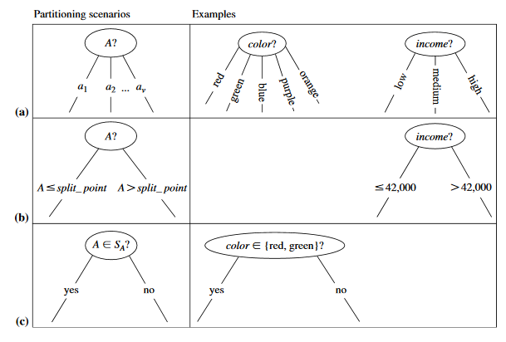
Splitting criteria…contd
a) Discrete-valued b) Continuous-valued c) discrete-valued and binary tree

Slide 30
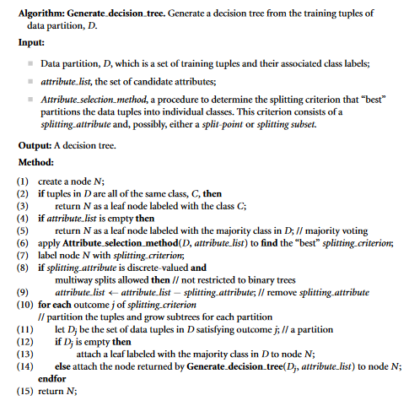
Decision-tree Algorithm

Slide 31
General Structure of Hunt’s Algorithm
Hunt's algorithm is among the earliest. More complex algorithms were built upon it.
It grows a decision tree in a recursive fashion by partitioning the training records into successively purer subsets
Let D_{t} be the set of training records that reach a node t
General Procedure:
If D_{t} contains records that belong the same class y_{t}, then t is a leaf node labeled as y_{t}
If D_{t} is an empty set, then t is a leaf node labeled by the default class, y_{d}
If D_{t} contains records that belong to more than one class, use an attribute test to split the data into smaller subsets. Recursively apply the procedure to each subset.
D_{t}
?
PURE NODE VS IMPURED NODE..SPLIT THE IMPURED NODE….
REFUND YES AND CHEAT IS NO (NO-CHEAT).. OUT OF 10 instances; 3 of them are yes..REFUND YES AND CHAT NO => 3 .. NO MIXES.. If it is pure.. No split.. Necessary.. (single class..)
But for for REFUND NO and CHAT IS YES => OUT OF 7 Instances; 4 pure;3 impure; (more than one class).. Then split is necessary… (split the attributes..)

Slide 32
Hunt’s Algorithm
Don’t
Cheat
Refund
Yes
No
Don’t
Cheat
Don’t
Cheat
Refund
Refund
Yes
No
Yes
No
Don’t
Cheat
Marital
Status
Don’t
Cheat
Marital
Status
Single,
Divorced
Single,
Divorced
Married
Married
Taxable
Income
Don’t
Cheat
Cheat
Don’t
Cheat
< 80K
>= 80K
Don’t
Cheat
Cheat

Slide 33
How to Specify Test Condition?
Depends on attribute types
Nominal
Ordinal
Continuous
Depends on number of ways to split
2-way split
Multi-way split

Slide 34
Splitting Based on Nominal Attributes
Multi-way split: Use as many partitions as distinct values.
Binary split: Divides values into two subsets. Need to find optimal partitioning.
CarType
Family
Luxury
Sports
CarType
CarType
{Sports, Luxury}
{Family}
OR
{Family, Luxury}
{Sports}

Slide 35
Splitting Based on Ordinal Attributes
Multi-way split: Use as many partitions as distinct values.
Binary split: Divides values into two subsets. Need to find optimal partitioning.
What about this split?
Size
Small
Large
Medium
{Small, Medium}
Size
OR
Size
{Large}
{Medium, Large}
{Small}
Size
{Small, Large}
{Medium}

Slide 36
Splitting Based on Continuous Attributes
Different ways of handling
Discretization to form an ordinal categorical attribute
Static – discretize once at the beginning
Dynamic – ranges can be found by equal interval bucketing, equal frequency bucketing (percentiles), or clustering.
Binary Decision: (A < v) or (A ≥ v)
consider all possible splits and finds the best cut
can be more compute intensive

Slide 37
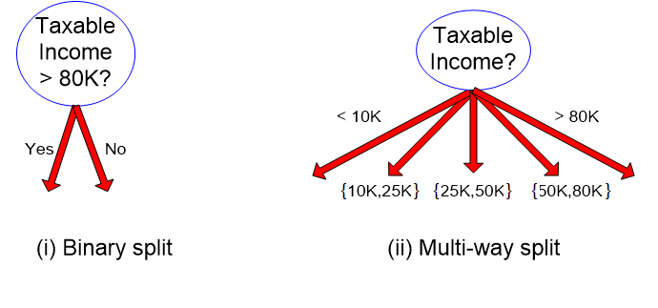
Splitting Based on Continuous Attributes

Slide 38
How to determine the Best Split
Before Splitting: 10 records of class 0, 10 records of class 1
Which test condition is the best?

Slide 39
How to determine the Best Split
Greedy approach:
Nodes with homogeneous class distribution are preferred
Need a measure of node impurity:
Non-homogeneous,
High degree of impurity
Homogeneous,
Low degree of impurity

Slide 40
Attribute Selection Measures
Also, known as Splitting rules
Measure is a heuristic for selecting the splitting criterion that “best” separates a given data partition D, of class-labeled training tuples into individual classes.
Partition should be pure (i.e., all the tuples that fall into a given partition would belong to the same class).
Provides ranking to each attribute of training tuple, and the attribute having “best” score is chosen as the splitting attribute.

Slide 41
Measures of Node Impurity
Gini Index
Entropy
Misclassification error
According to Wikipedia, Entropy refers to disorder or uncertainty. Definition: Entropy is the measures of impurity, disorder or uncertainty in a bunch of examples.

Slide 42
How to Find the Best Split
Before Splitting:
M0
A?
B?
Yes
No
Yes
No
Node N1
Node N2
Node N3
Node N4
M1
M2
M3
M4
M12
Gain = M0 – M12 vs M0 – M34
M34

Slide 43
Measure of Impurity: GINI
Gini Index for a given node t :
(NOTE: p( j | t) is the relative frequency of class j at node t).
Maximum (1 - 1/n_{c}) when records are equally distributed among all classes, implying least interesting information
Minimum (0.0) when all records belong to one class, implying most interesting information

Slide 44
Examples for computing GINI
P(C1) = 0/6 = 0 P(C2) = 6/6 = 1
Gini = 1 – P(C1)² – P(C2)² = 1 – 0 – 1 = 0
P(C1) = 1/6 P(C2) = 5/6
Gini = 1 – (1/6)² – (5/6)² = 0.278
P(C1) = 2/6 P(C2) = 4/6
Gini = 1 – (2/6)² – (4/6)² = 0.444

Slide 45
Splitting Based on GINI
Used in CART, SLIQ, SPRINT.
When a node p is split into k partitions (children), the quality of split is computed as,
where, n_{i} = number of records at child i,
n = number of records at node p.

Slide 46
Binary Attributes: Computing GINI Index
Splits into two partitions
Effect of Weighing partitions:
Larger and Purer Partitions are sought for.
B?
Yes
No
Gini(N1) = 1 – (5/7)² – (2/7)² = 0.408
Gini(N2) = 1 – (1/5)² – (4/5)² = 0.32
Node N1
Node N2
Gini(Children) = 7/12 * 0.408 + 5/12 * 0.32 = 0.37

Slide 47
Categorical Attributes: Computing Gini Index
For each distinct value, gather counts for each class in the dataset
Use the count matrix to make decisions
Multi-way split
Two-way split
(find best partition of values)

Slide 48
Continuous Attributes: Computing Gini Index
Use Binary Decisions based on one value
Several Choices for the splitting value
Number of possible splitting values = Number of distinct values
Each splitting value has a count matrix associated with it
Class counts in each of the partitions, A < v and A ≥ v
Simple method to choose best v
For each v, scan the database to gather count matrix and compute its Gini index
Computationally Inefficient! Repetition of work.

Slide 49
Continuous Attributes: Computing Gini Index...
For efficient computation: for each attribute,
Sort the attribute on values
Linearly scan these values, each time updating the count matrix and computing gini index
Choose the split position that has the least gini index
Sorted Values
Split Positions

Slide 50
Computing Information-Gain for Continuous-Valued Attributes
Let attribute A be a continuous-valued attribute
Must determine the best split point for A
Sort the value A in increasing order
Typically, the midpoint between each pair of adjacent values is considered as a possible split point
(a_{i}+a_{i+1})/2 is the midpoint between the values of a_{i} and a_{i+1}
The point with the minimum expected information requirement for A is selected as the split-point for A
Split:
D1 is the set of tuples in D satisfying A ≤ split-point, and D2 is the set of tuples in D satisfying A > split-point

Slide 51
Gain Ratio for Attribute Selection (C4.5)
Information gain measure is biased towards attributes with a large number of distinct values. Eg. Product_ID (unique for every tuple), resulting in large number of partitions as Info_{product_ID} (D) = 0, Such partitioning is useless.
C4.5 (a successor of ID3) uses gain ratio to overcome the problem.
It applies normalization to information gain using a “split information”
GainRatio(A) = Gain(A)/SplitInfo_{A} (D)
Ex. Gain Ratio of “income” on the given data set.
gain_ratio(income) = 0.029/1.557 = 0.019
The attribute with the maximum gain ratio is selected as the splitting attribute

Slide 52
Gini Index (CART, IBM IntelligentMiner)
If a data set D contains examples from n classes, gini index, gini(D) is defined as
where p_{j} is the probability that a tuple in D belongs to class j is |C_{j,D} |/|D|
It considers binary-split for each attribute
If a data set D is split on A (such that A∈ S_{A}?) into two subsets D₁ and D₂, the gini index gini(D) is defined as
Reduction in Impurity:
The attribute provides the minimum gini_{split}(D) (or the largest reduction in impurity) is chosen to split the node (need to enumerate all the possible splitting points for each attribute)

Slide 53
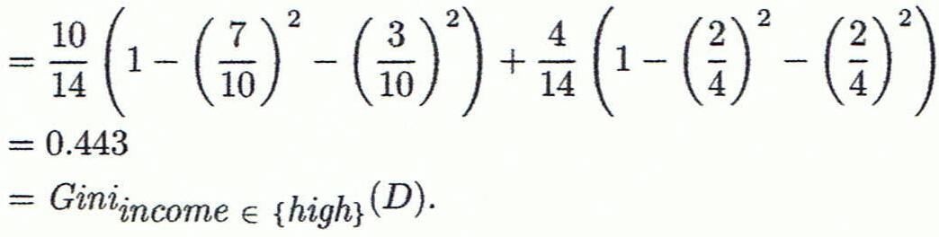
Computation of Gini Index
Ex. D has 9 tuples in buys_computer = “yes” and 5 in “no”
Suppose the attribute income partitions D into 10 in D₁: {low, medium} and 4 in D₂
Gini_{{low,high}} is 0.458; Gini_{{medium,high}} is 0.450. Thus, split on the {low,medium} (and {high}) since it has the lowest Gini index
May need other tools, e.g., clustering, to get the possible split values
Can be modified for categorical attributes

Slide 54
Alternative Splitting Criteria
Entropy at a given node t:
(NOTE: p( j | t) is the relative frequency of class j at node t).
Measures homogeneity of a node.
Maximum (log n_{c}) when records are equally distributed among all classes implying least information
Minimum (0.0) when all records belong to one class, implying most information
Entropy based computations are similar to the GINI index computations

Slide 55
Examples for computing Entropy
P(C1) = 0/6 = 0 P(C2) = 6/6 = 1
Entropy = – 0 log 0 – 1 log 1 = – 0 – 0 = 0
P(C1) = 1/6 P(C2) = 5/6
Entropy = – (1/6) log₂ (1/6) – (5/6) log₂ (1/6) = 0.65
P(C1) = 2/6 P(C2) = 4/6
Entropy = – (2/6) log₂ (2/6) – (4/6) log₂ (4/6) = 0.92

Slide 56
Splitting Criteria based on Classification Error
Classification error at a node t :
Measures misclassification error made by a node.
Maximum (1 - 1/n_{c}) when records are equally distributed among all classes, implying least interesting information
Minimum (0.0) when all records belong to one class, implying most interesting information

Slide 57
Examples for Computing Error
P(C1) = 0/6 = 0 P(C2) = 6/6 = 1
Error = 1 – max (0, 1) = 1 – 1 = 0
P(C1) = 1/6 P(C2) = 5/6
Error = 1 – max (1/6, 5/6) = 1 – 5/6 = 1/6
P(C1) = 2/6 P(C2) = 4/6
Error = 1 – max (2/6, 4/6) = 1 – 4/6 = 1/3

Slide 58
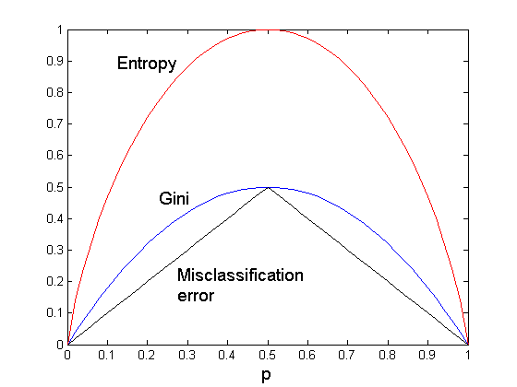
Comparison among Splitting Criteria
For a 2-class problem:

Slide 59
Stopping Criteria for Tree Induction
Stop expanding a node when all the records belong to the same class
Stop expanding a node when all the records have similar attribute values
Early termination

Slide 60
Decision Tree Based Classification
Advantages:
Inexpensive to construct
Extremely fast at classifying unknown records
Easy to interpret for small-sized trees
Accuracy is comparable to other classification techniques for many simple data sets

Slide 61
Practical Issues of Classification
Underfitting and Overfitting
Missing Values
Costs of Classification

Slide 62
Underfitting vs. Overfitting
Underfitting results in decision trees that are too simple to solve the problem. They may offer superior interpretability.
Overfitting results in decision trees that are more complex than necessary
Training error no longer provides a good estimate of how well the tree will perform on previously unseen records
Need new ways for estimating errors

Slide 63
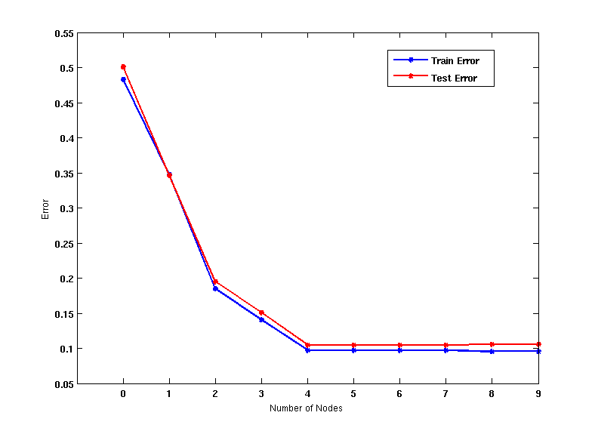
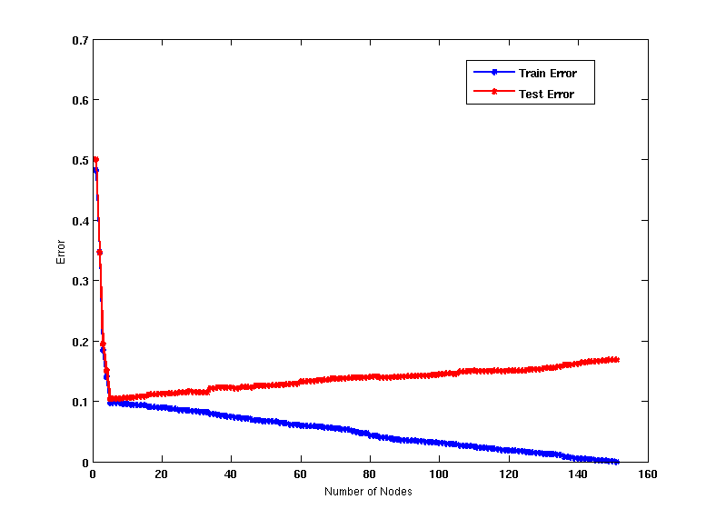
Model Overfitting
Underfitting: when model is too simple, both training and test errors are large
Overfitting: when model is too complex, training error is small but test error is large

Slide 64
How to Address Overfitting
Pre-Pruning (Early Stopping Rule)
Stop the algorithm before it becomes a fully-grown tree
General stopping conditions for a node:
Stop if all instances belong to the same class
Stop if all the attribute values are the same
More restrictive conditions (for pre-pruning) :
Stop if number of instances is less than some user-specified threshold
Stop if class distribution of instances are independent of the available features (e.g., using χ ² test)
Stop if expanding the current node does not improve impurity measures (e.g., Gini or information gain).

Slide 65
How to Address Overfitting…
Post-pruning
Grow decision tree to its entirety
Trim the nodes of the decision tree in a bottom-up fashion
If generalization error(i.e. expected error of the model on previously unseen records) improves after trimming, replace sub-tree by a leaf node.
Class label of leaf node is determined from majority class of instances in the sub-tree

Slide 66
Prescribed Text Books
 | Author(s), Title, Edition, Publishing House
T1 | Tan P. N., Steinbach M & Kumar V. “Introduction to Data Mining” Pearson Education
T2 | Data Mining: Concepts and Techniques, Third Edition by Jiawei Han, Micheline Kamber and Jian Pei Morgan Kaufmann Publishers
R2 | Principles of Data Mining, Second Edition by Max Bramer Springer © 2013
R1 | Predictive Analytics and Data Mining: Concepts and Practice with RapidMiner by Vijay Kotu and Bala Deshpande Morgan Kaufmann Publishers

Slide 67
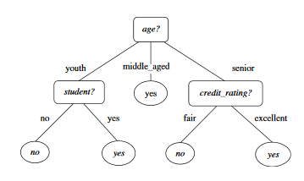
Decision Tree
Decision tree for the concept “buys_computer”

Slide 68
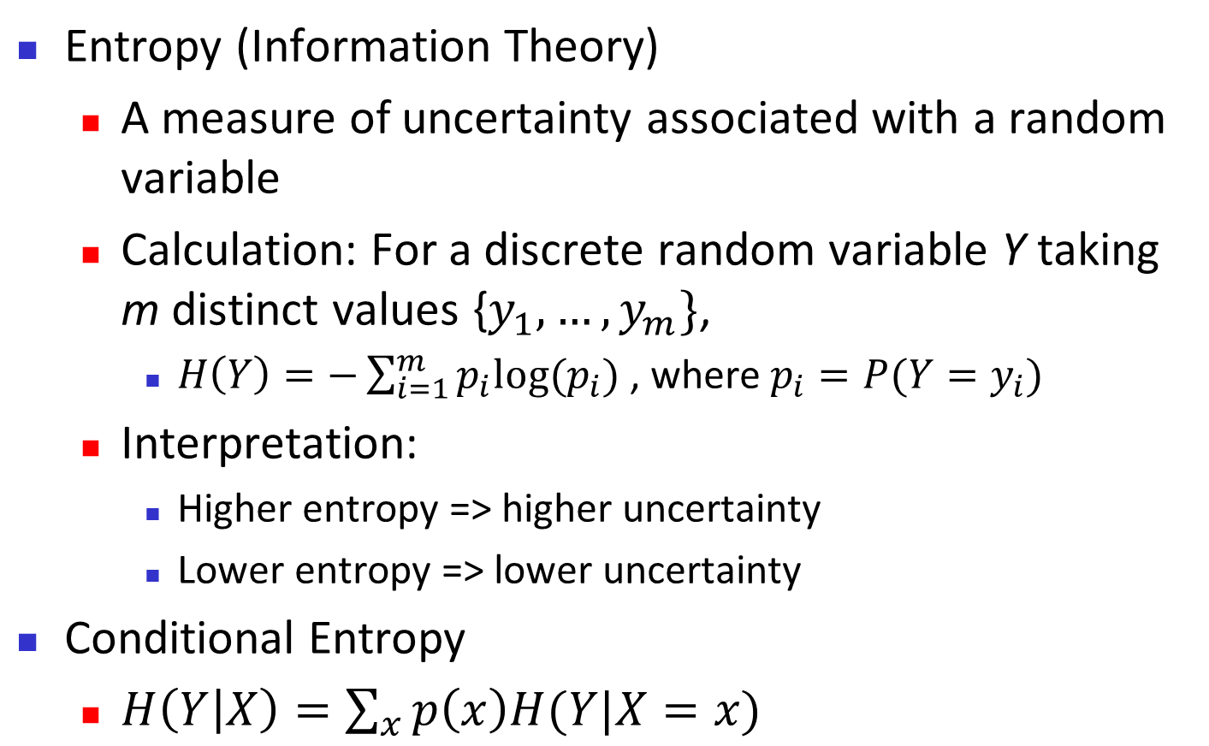
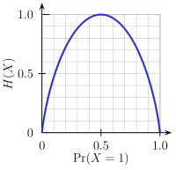
Brief Review / Recap of Entropy
m = 2

Slide 69
Attribute Selection Measure: Information Gain (ID3/C4.5)
Select the attribute with the highest information gain
This attribute minimizes the expected number of tests needed to classify a given tuple.
Let p_{i} be the probability that a tuple in D belongs to class C_{i}, estimated by |C_{i, D}|/|D|, m is the number of distinct classes, v is the number of distinct values in an attribute.
Expected information (entropy) needed to classify a tuple in D:
Information needed (after using A to split D into v partitions) to classify D
The smaller the expected information required, greater the purity of the partitions.

Slide 70
Attribute Selection Measure: Information Gain (ID3/C4.5)
Information gained by branching on attribute A
Defined as the difference between the original information requirement (i.e. based on just the proportion of the classes) and the new requirement (i.e. obtained after partitioning of attribute A).
Attribute with highest information gain Gain(A), is chosen as the splitting attribute at node N.
Notes:
I : the expected information needed to classify a given sample
E (entropy) : expected information based on the partitioning into subsets by A

Slide 71
Attribute Selection: Information Gain
Class P: buys_computer = “yes”
Class N: buys_computer = “no”
means “age <=30” has 5 out of 14 samples, with 2 yes’es and 3 no’s.
Similarly,

Slide 72
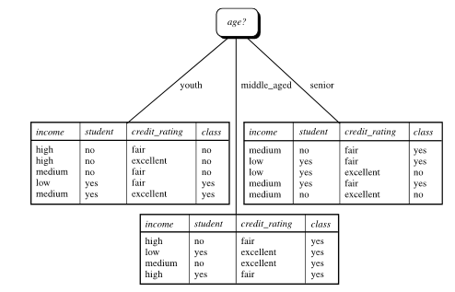
Attribute Selection: Information Gain

